Slide 1




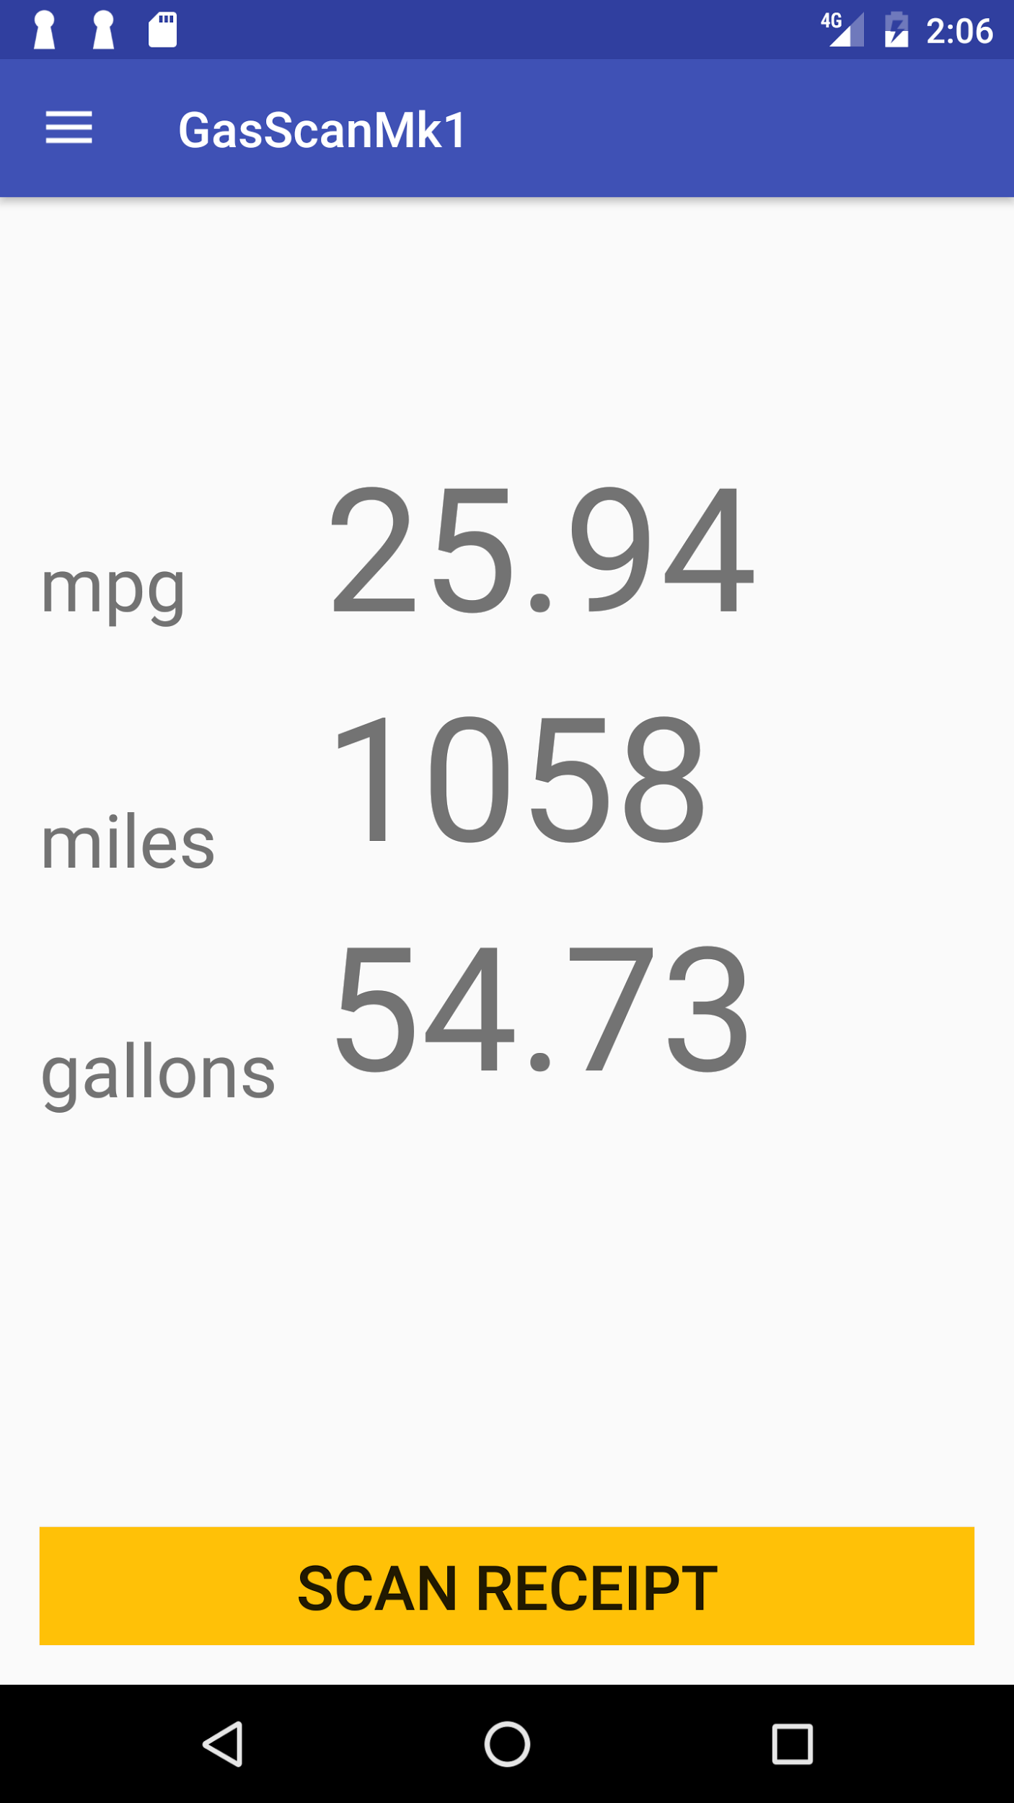
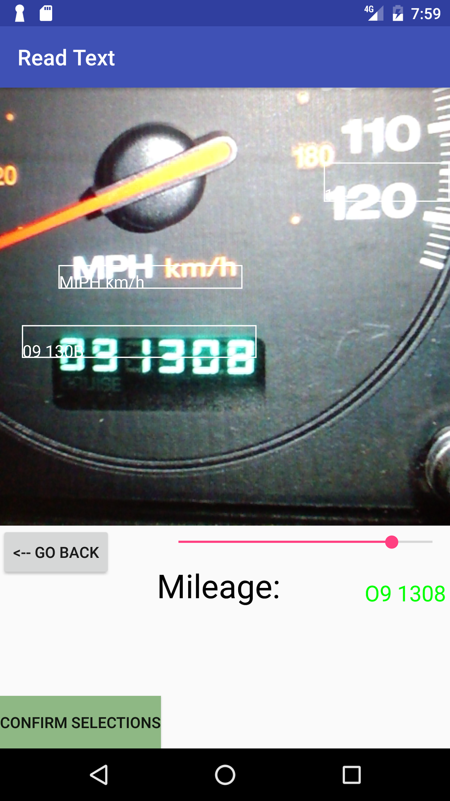
Gas Scan: Measuring Fuel Economy With OCR and Firebase
Fall 2016
Taylor Coomer Tanner Thurman
Advisor: Bob Bradley
Goal
Requirements
Limit the need for user interaction - rely on automation via OCR.
Data is kept in a safe, responsive online database protected against various attacks and forms of loss.
Application design is left simple, and intuitive and the option for manual input left in tact.
To enable users to track their fuel economy more easily and accurately than if they kept records on paper or relied upon their vehicle’s native fuel economy measurements.
Design Process
Create the basic layout and design of the application. Simple and clean.
Database created through Firebase, and OCR parsing back-bone provided by Mobile Vision, both are set-up in the application’s dependencies.
Populate the database, and test calculations in the application.
Implement additional parsing tools and fall-back entry methods for receipts for the OCR.
Finalize testing, and build with a signed key so the APK is ready for distribution on Google Play Store.
Software
Android Studio – Base development platform; Design and Android IDE
Firebase – Online cloud service. Houses real-time database and user authentication.
Mobile Vision – OCR (optical character recognition) API. Used to retreive data from receipts for calculations.
Conclusion
Accomplished Work:
- Database and user-authentication working in Firebase.
- Calculations work properly and accurately.
- Application design is as desired.
-OCR base functionality implemented.
Future Work:
iOS version
Fine-tune OCR parsing for more automated experience.
Begin work on a map of gas stations that updates with the most recent price per gallon.

